Slide 1
Converting Innovation into a Startup

Slide 2
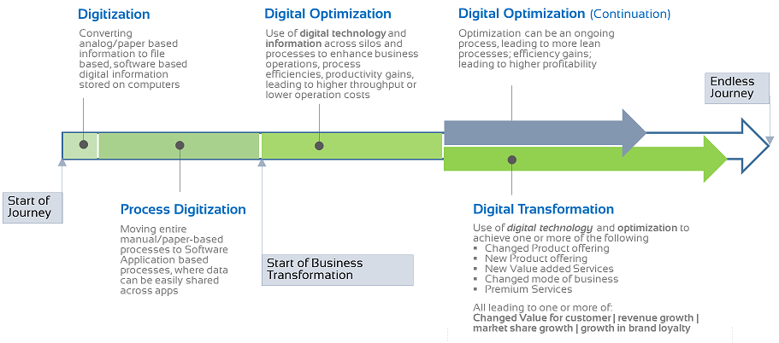
Journey of Digital Transformation
1900
2000
2010
Solution Type
Silo: FA, Payroll, Website…
Integrated: ERP, CRM, HRMS…
Digital: Cloud, Mobile, IoT, Social Media, AI/ML, Big data….

Slide 3
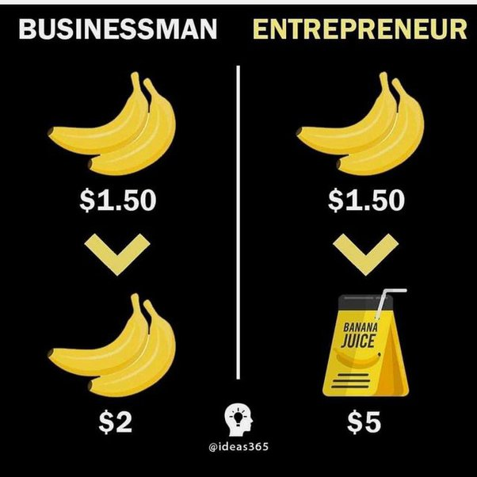
Businessman vs Entrepreneur
Start a business from an existing idea
Traditional
Avoid taking risks
Profit oriented
Market “Player”
Start a business from a unique & innovative idea
Revolutionary
Risk taker
People (customer) oriented
Market “Leader”
Entrepreneurs are innovative.
Source: quora.com

Slide 4
Product Lifecycle
Idea
Proof of Concept (POC)
Prototype
Min. Viable Product (MVP)
Full-fledged Product
Production

Slide 5
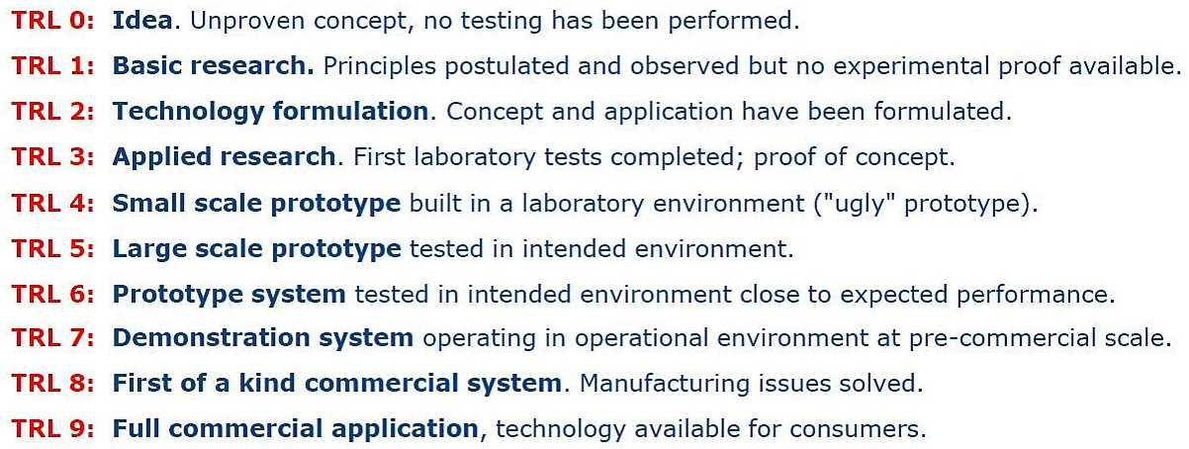
TRL (Technology Readiness Level): European Union
Source: serkanbolat.com

Slide 6
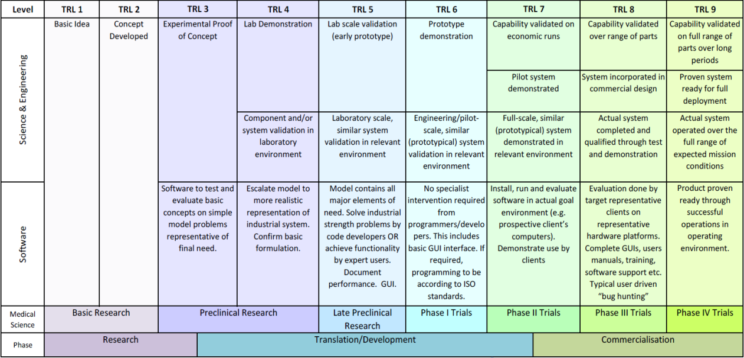
TRL (Technology Readiness Level)

Slide 7
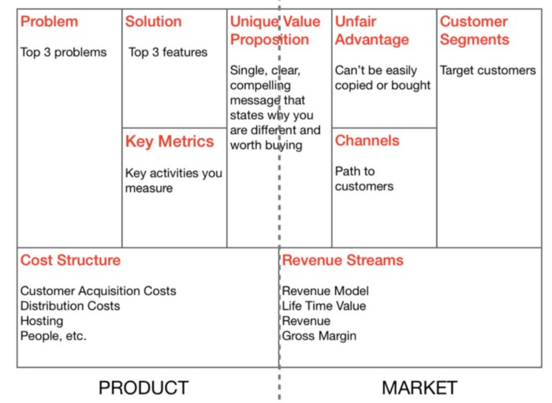
Lean Canvas - Blank

Slide 8
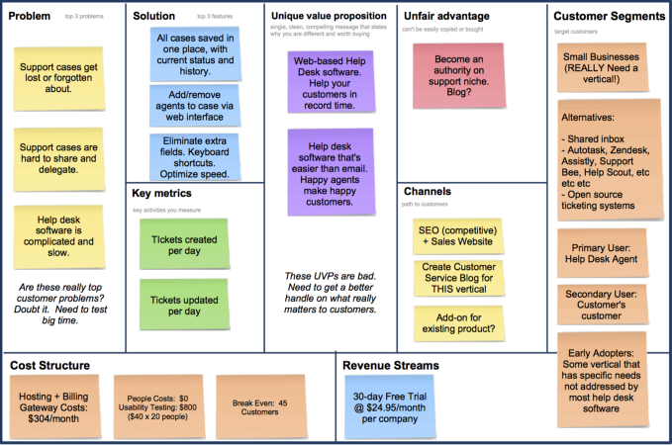
Lean Canvas - Filled
source: StartitUp

Slide 9
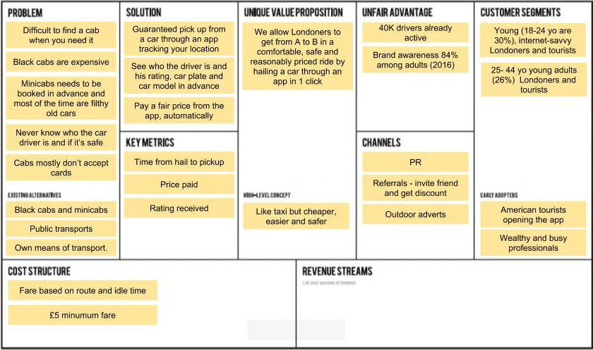
Lean Canvas - Uber

Slide 10
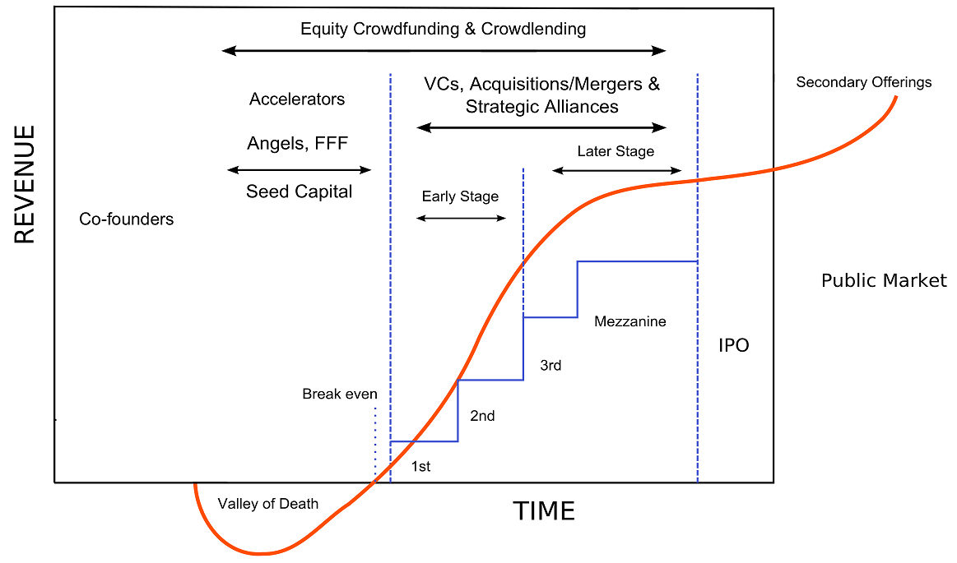
Startup Financial Cycle
source: wikipedia.org

Slide 11
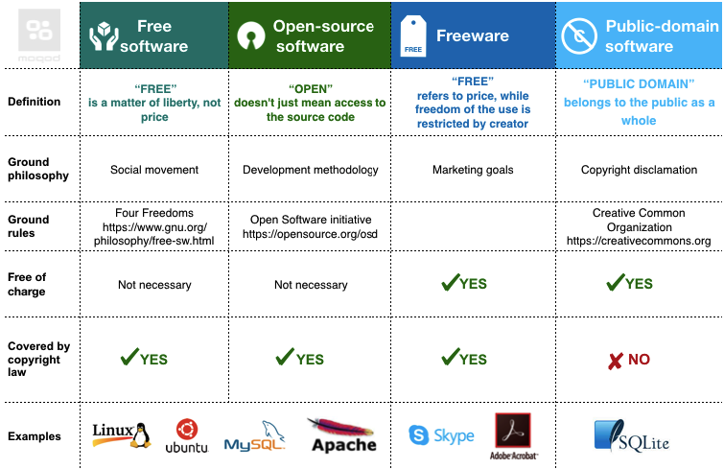
Type of Free and open-source software (FOSS)

Slide 12
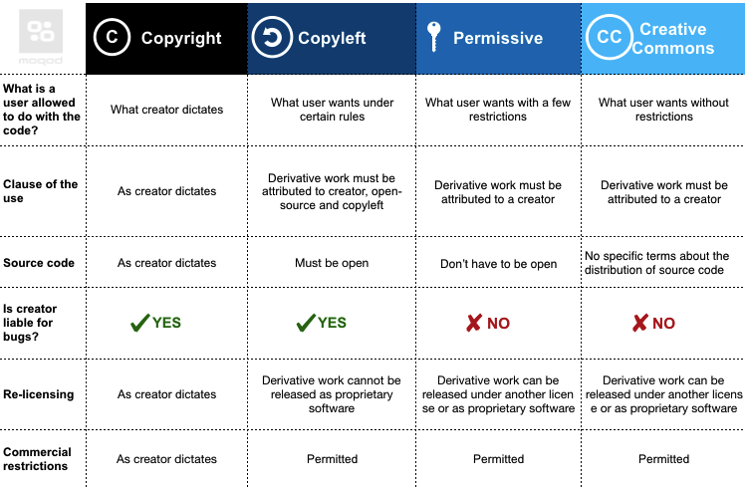
Copyright vs Copyleft vs Permissive vs Creative Common

Slide 13
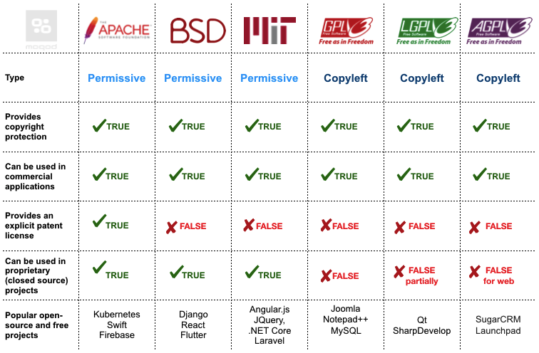
Open Source Licensing

Slide 14
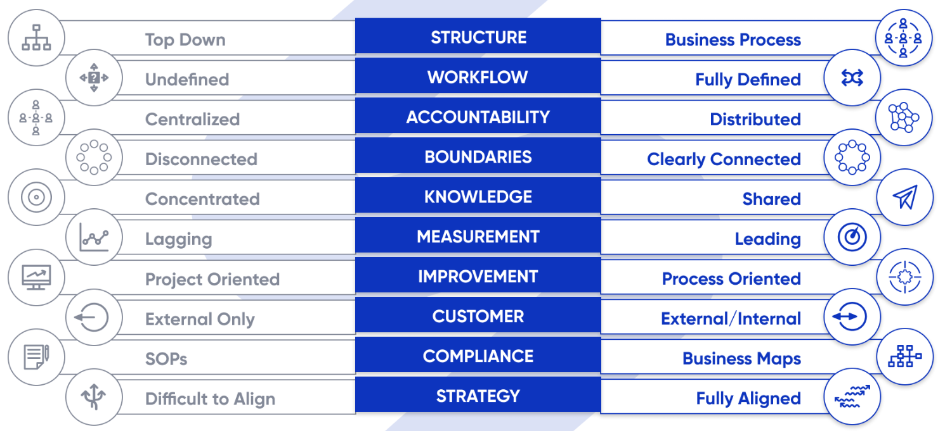
Traditional vs Process-based Organization
Source: businessmapping.com

Slide 15
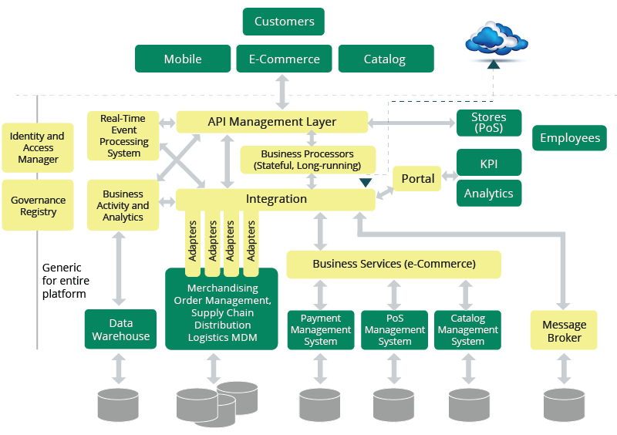
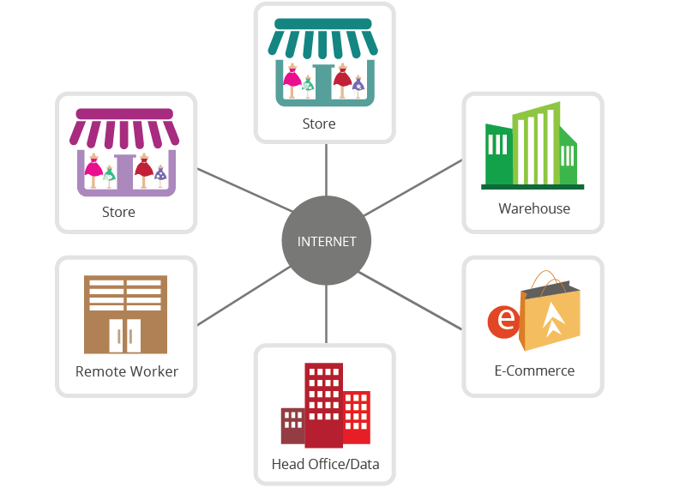
Retail Reference Architecture
IT landscape of Retail Enterprise
Stores - point of sale (POS)
Back offices for each store (linking the POS and the central data center)
Central data center or head office containing
Proprietary systems (e.g. ERP systems)
Data repositories
External data sources (e.g. Payment systems)
Source: wso2.com

Slide 16
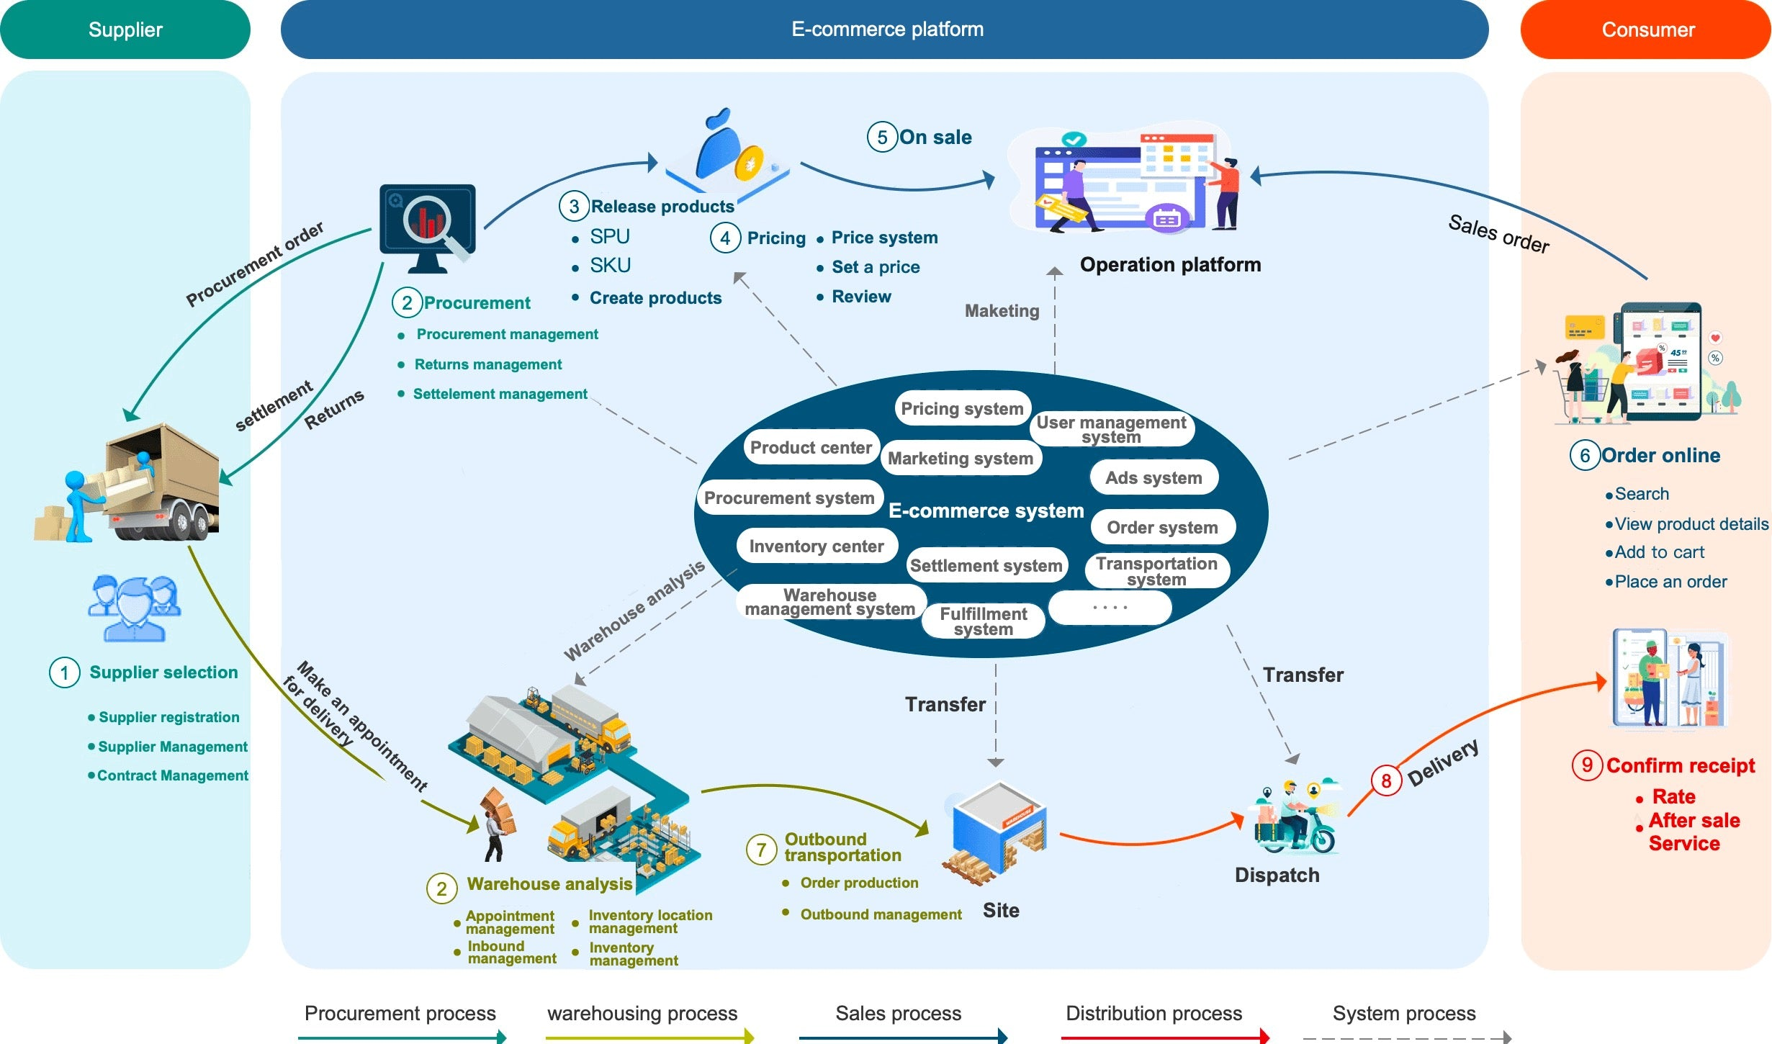
E-commerce Platform Business
Source: https://axureboutique.com/blogs/product-design/understanding-the-structure-of-e-commerce-products

Slide 17
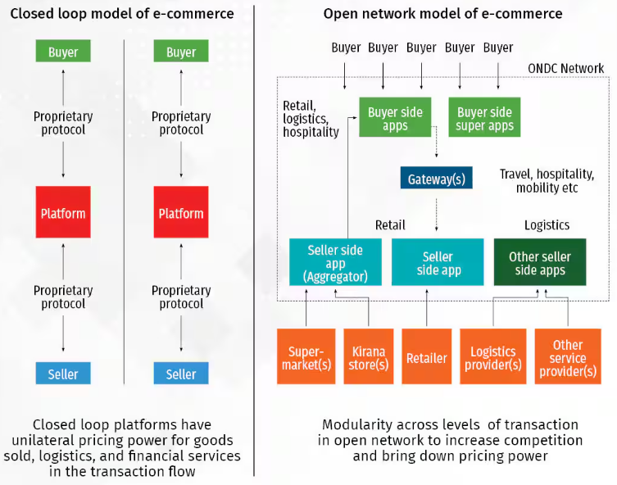
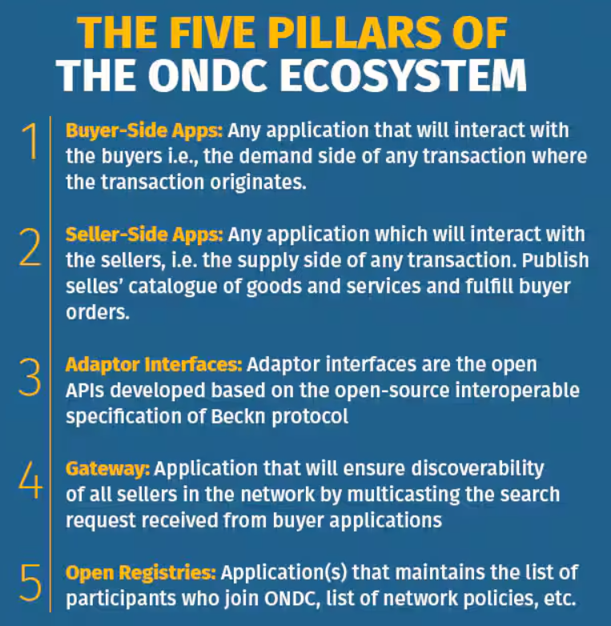
Open Network for Digital Commerce (ONDC)
Build a digital standard for the e-commerce industry that allows any seller to connect with any buyer on the network
Source: moneycontrol.com

Slide 18
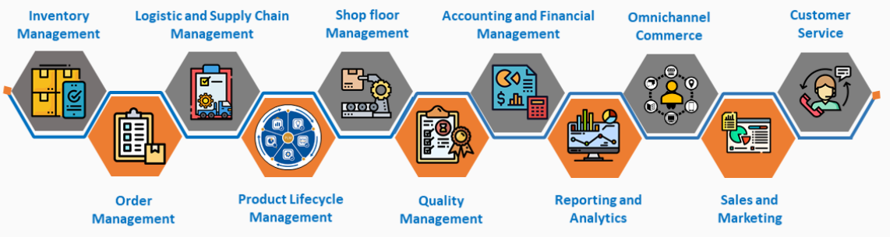
Manufacturers Business Process & Lean Manufacturing
Five Principles Of Lean Manufacturing:
1: Accurately specify the value from the customer's perspective for both products and services.
2: Identify the value stream for products and services and remove any non-value-added waste along the value stream.
3: Make the product and services flow without interruption across the value stream.
4: Authorize production of products and services based on the pull from the customer.
5: Strive for perfection by constantly removing layers of waste.
Common Tools and Techniques of Lean Manufacturing:
5S: A workplace organization method that includes Sort, Set in order, Shine, Standardize, and Sustain.
Kaizen: Continuous improvement through small, incremental changes.
Kanban: A scheduling system that helps manage workflow and inventory.
Value Stream Mapping: A visual tool to map out and analyze the flow of materials and information required to bring a product to the customer.
JIT (Just-In-Time): A strategy to increase efficiency by receiving goods only as they are needed in the production process.
Poka-Yoke: A mistake-proofing technique designed to prevent errors in the manufacturing process.
TPM (Total Productive Maintenance): A proactive approach to maintaining and improving production and quality systems through equipment, processes, and employees.

